Slide 1
Natural Selection
Inspired by a true story.

Slide 2
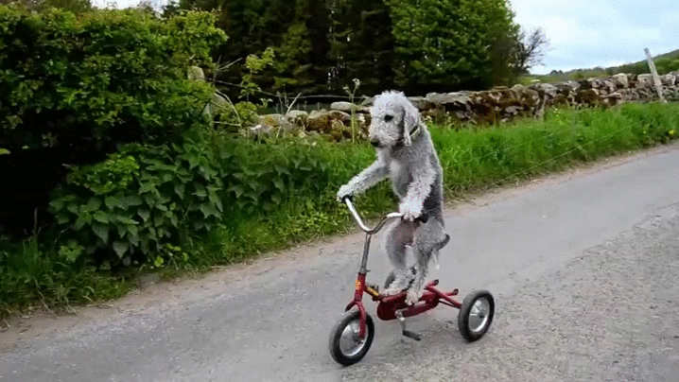
MECHANISMS

Slide 3
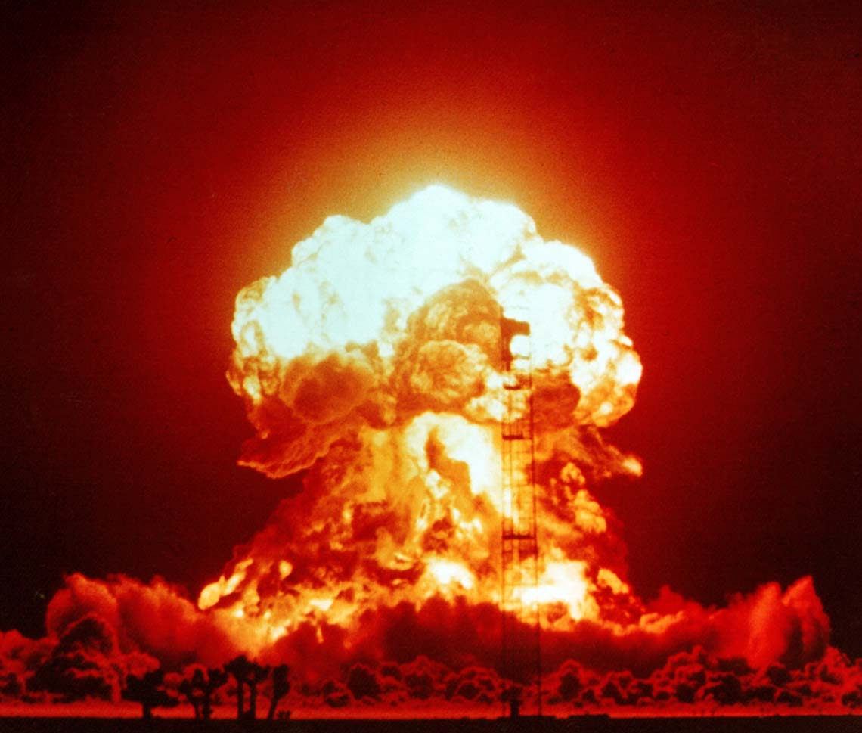
IMPACT

